Slide 1
2018 1098t Process
New 1098t System

Slide 2
The New, easy process

Slide 3
Log IN
The URL for clients will be:
1098.UASNorthStar.com
The URL for students will be:
1098.UASConnect.com

Slide 4
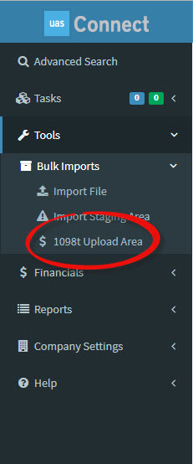
UPLOAD
On the left hand menu, you will see an option for BULK IMPORTS. Click on the drop down and you will see the 1098t Upload Area. Click on that link.

Slide 5
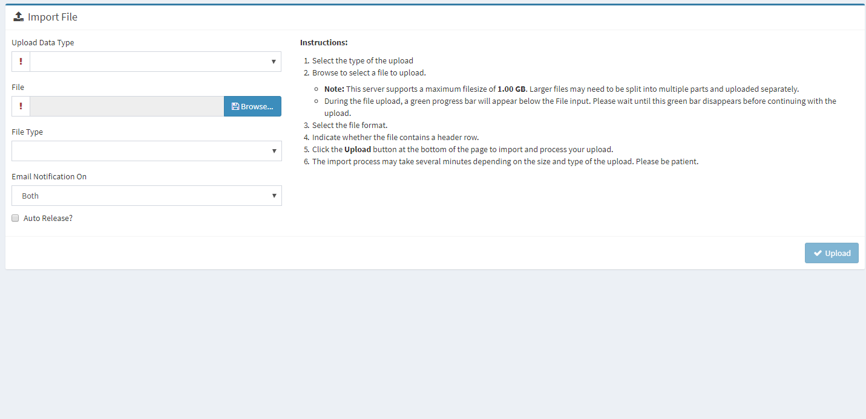
Under Upload Data Type, select 1098t from the menu. Select the file from your computer. Select your email notification preferences. Then, click UPLOAD.

Slide 6
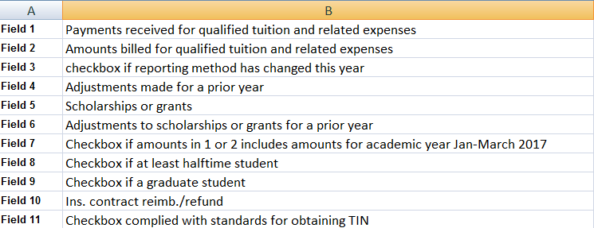
Field Definitions In The Spreadsheet
The field definitions have not changed since last year. We will make sure that the correct information ends up in the correct places on the forms in the back end, with no extra work to you.

Slide 7
Connect For Students
Getting the 1098t to the students

Slide 8
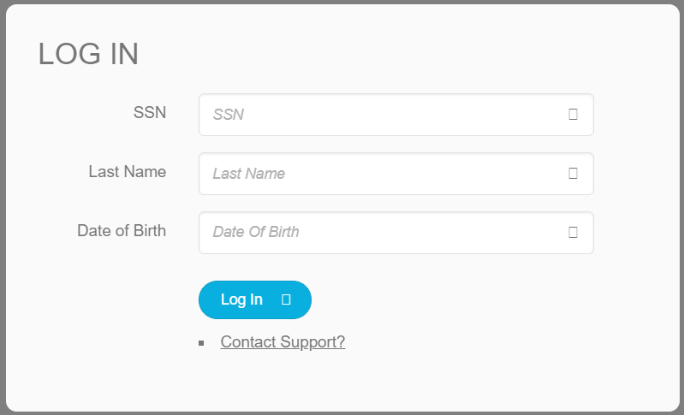
1098.UASConnect.Com
The process for the student, or their parent, to log in and access their file is very simple, and uses only information the student already has.

Slide 9
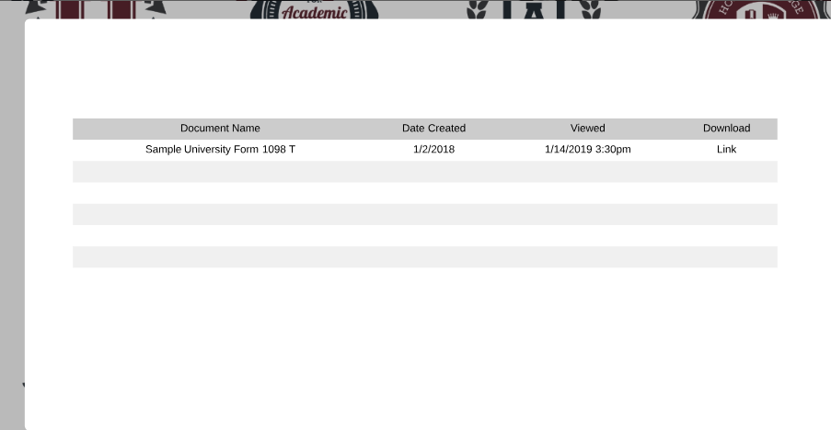
What The Students See
When the students hit the link that says “My Documents” they will see this screen with an option to download the file.

Slide 10
Any student who does not view the portal…
Any student who does not view their tax documents online will get a paper copy of their tax information in the mail by 1/31/19

